Slide 1
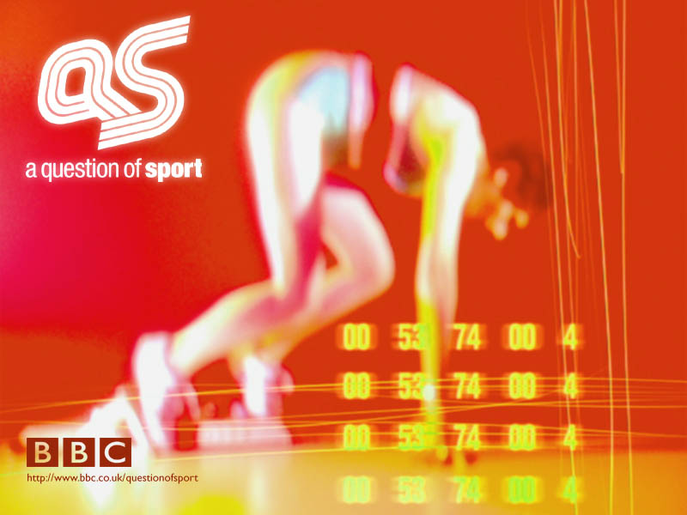
Picture Round

Slide 2
1
2
3
4
5
6
7
8
9
10
11
12

Slide 3
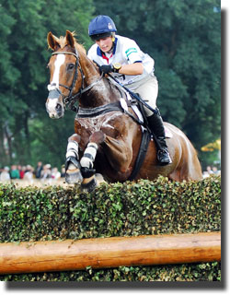
1

Slide 4
1
2
3
4
5
6
7
8
9
10
11
12

Slide 5
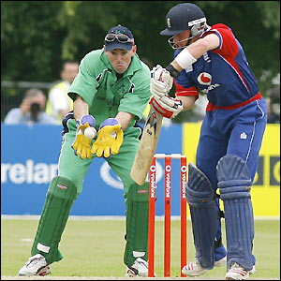
2

Slide 6
1
2
3
4
5
6
7
8
9
10
11
12

Slide 7
3

Slide 8
1
2
3
4
5
6
7
8
9
10
11
12

Slide 9
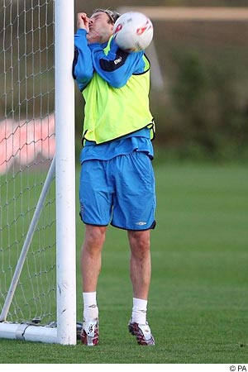
4

Slide 10
1
2
3
4
5
6
7
8
9
10
11
12

Slide 11
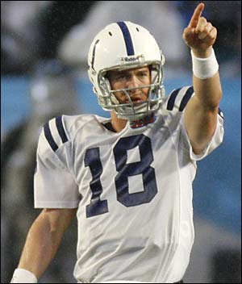
5

Slide 12
1
2
3
4
5
6
7
8
9
10
11
12

Slide 13
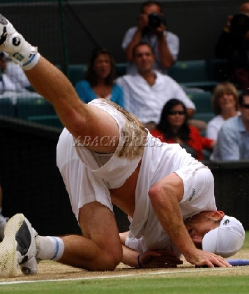
6

Slide 14
1
2
3
4
5
6
7
8
9
10
11
12

Slide 15
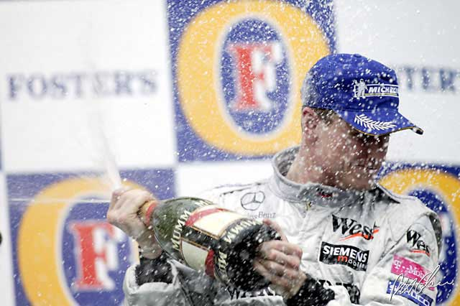
7

Slide 16
1
2
3
4
5
6
7
8
9
10
11
12

Slide 17
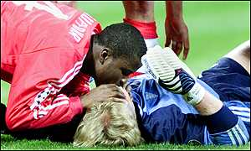
8

Slide 18
1
2
3
4
5
6
7
8
9
10
11
12

Slide 19
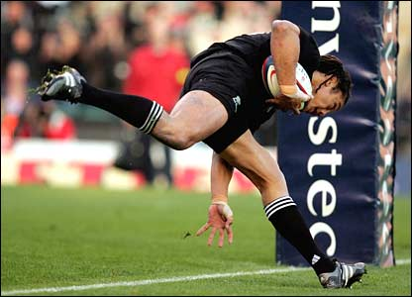
9

Slide 20
1
2
3
4
5
6
7
8
9
10
11
12

Slide 21
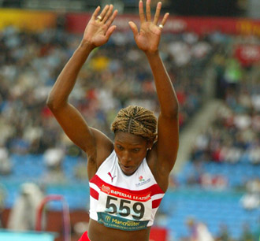
10

Slide 22
1
2
3
4
5
6
7
8
9
10
11
12

Slide 23
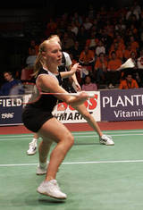
11

Slide 24
1
2
3
4
5
6
7
8
9
10
11
12

Slide 25
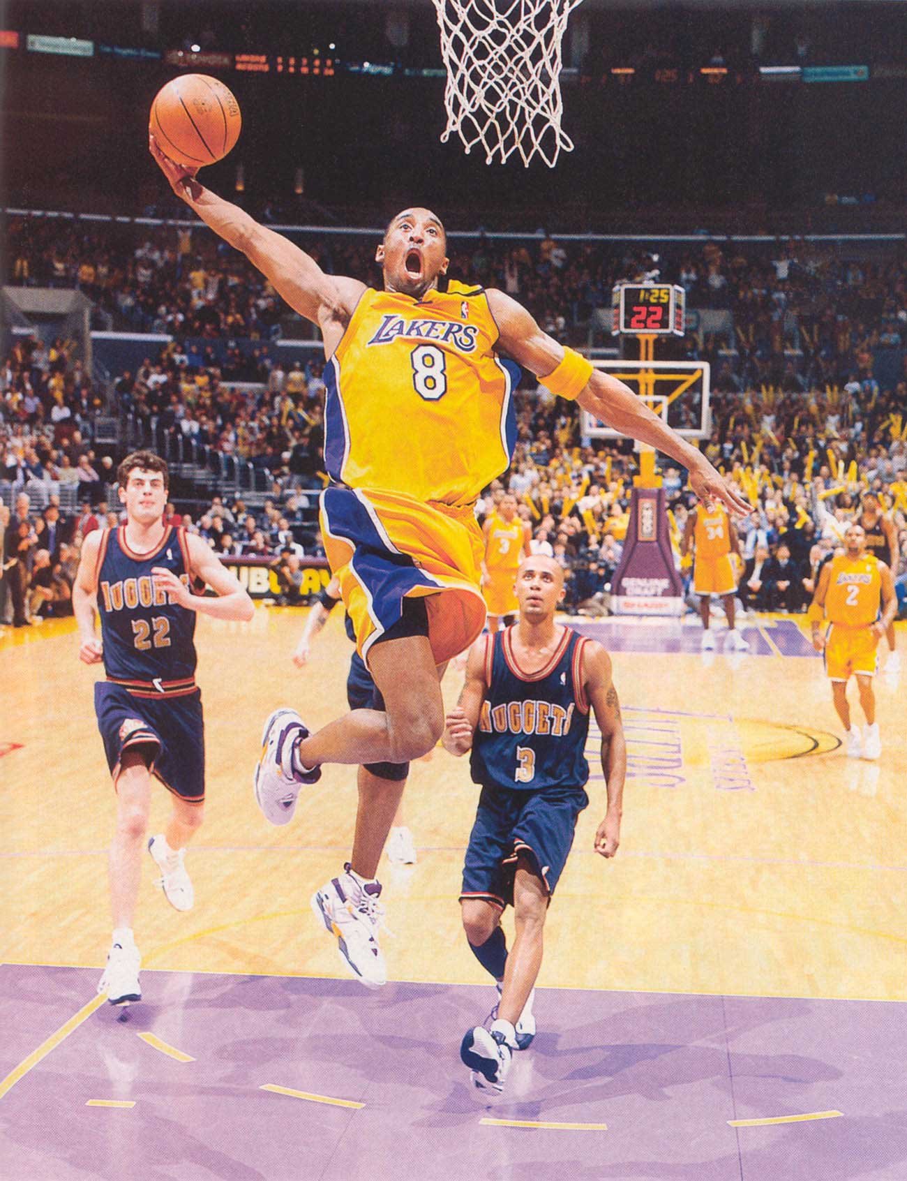
12

Slide 26
1
2
3
4
5
6
7
8
9
10
11
12

Slide 27
Answers
Zara Phillips
Jeremy Bray & Ian Bell
Annika Sorenstam
David Beckham
Peyton Manning
Andy Roddick
David Coulthard
Samuel Kuffour & Oliver Kahn
Tana Umaga
Ashia Hansen
Gail Emms
Kobe Bryant

